Slide 1
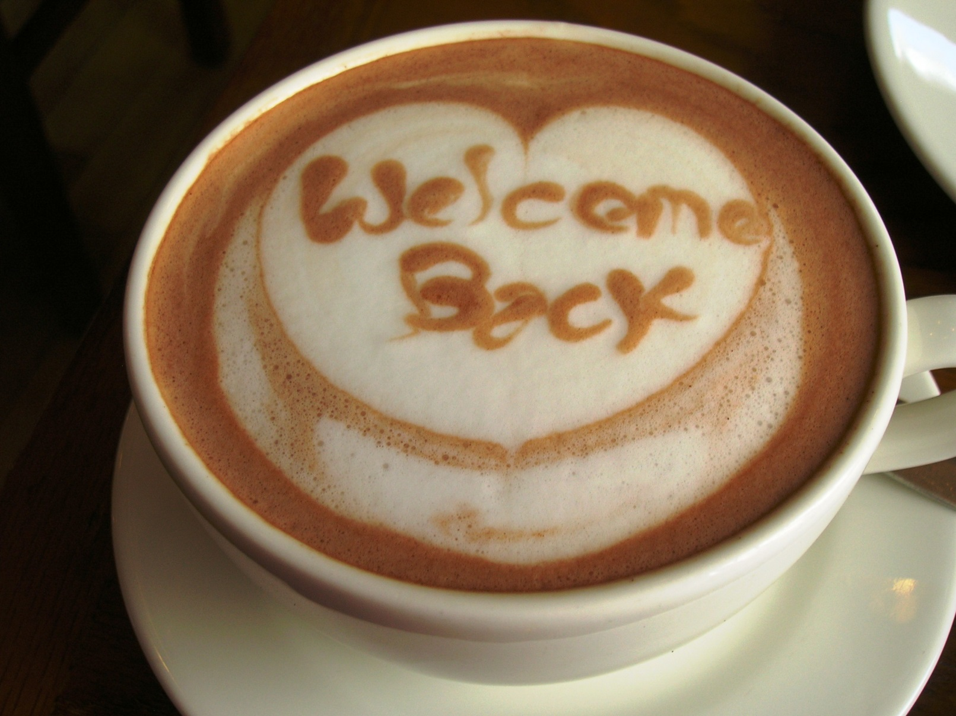
Review: Week Two
Notes:
Or you’ve met someone at an open house, or you’ve engaged in conversation at a restaurant… what do you do?

Slide 2
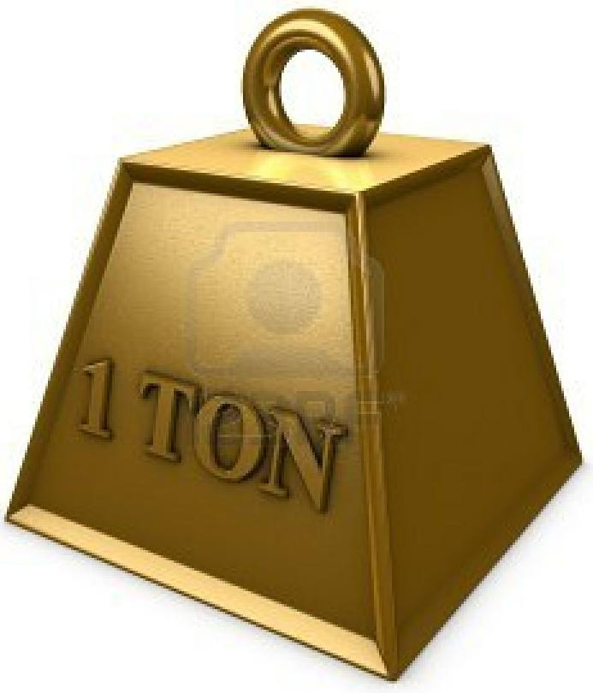
Let’s Review!
We’ve covered a TON of material!
1. Business Planning
2. Sphere of Influence
3. Sales Process – AID, INC
4. Buyer Orientation
6. Buy/Sell Contract
What are some successes?
What are some challenges?
What have you put into practice?

Slide 3
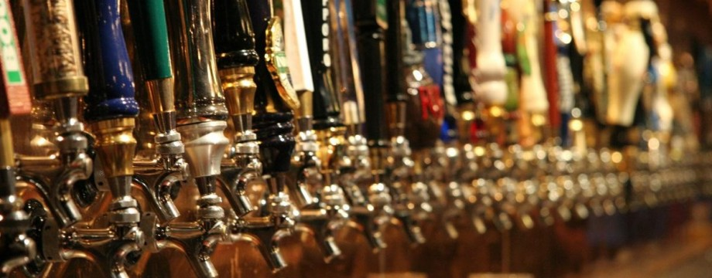
MODULE: Buyer Tour
No, I said
“BUYER Tour”
Notes:
You’ve done your Buyer Orientation. You’ve searched for properties, now what?

Slide 4
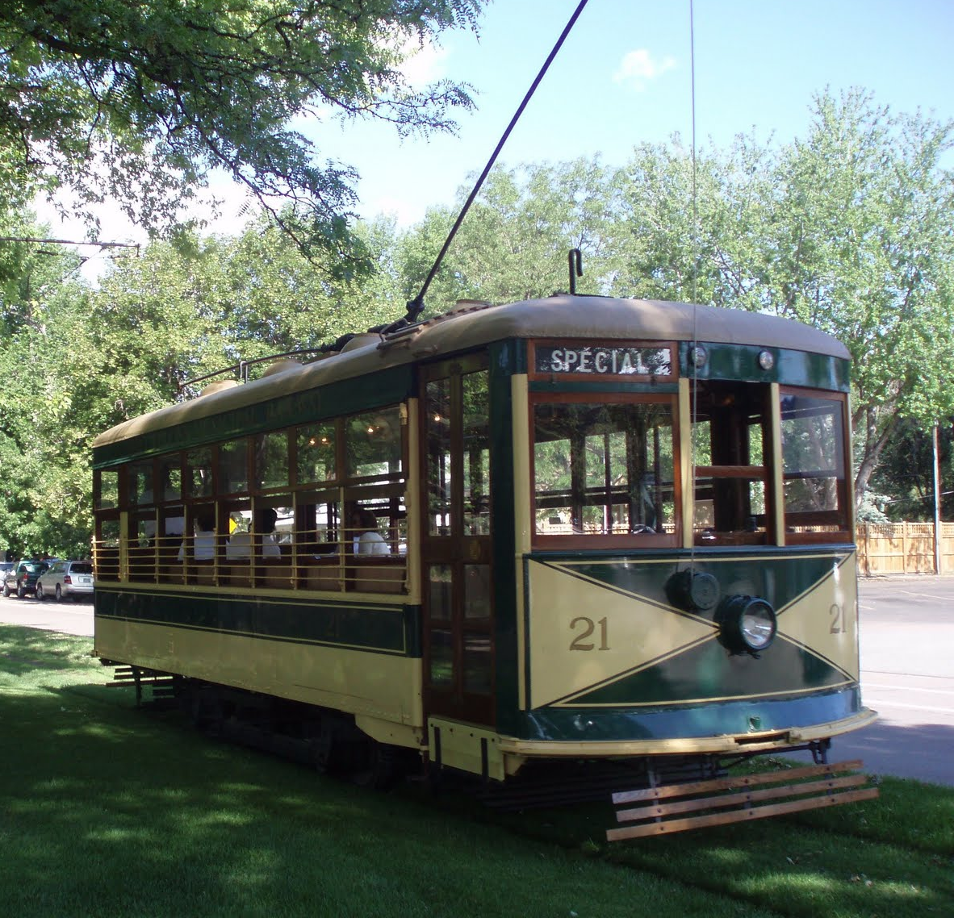
MODULE: Buyer Tour
When working with folks from out of the area, this can be a great way to build rapport and an emotional bond.
Notes:
You’ve done your Buyer Orientation. You’ve searched for properties, now what?

Slide 5
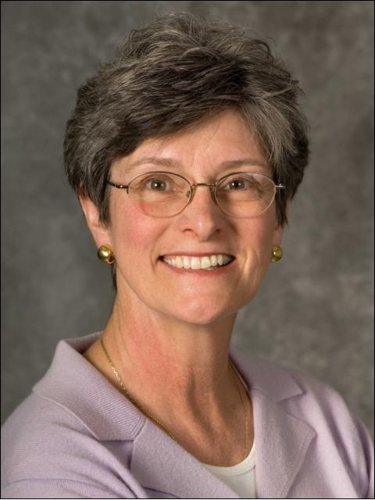
MODULE: Buyer Tour
Be sure to see Linda Hopkins’ Aerial Tour of
Fort Collins Presentation!

Slide 6
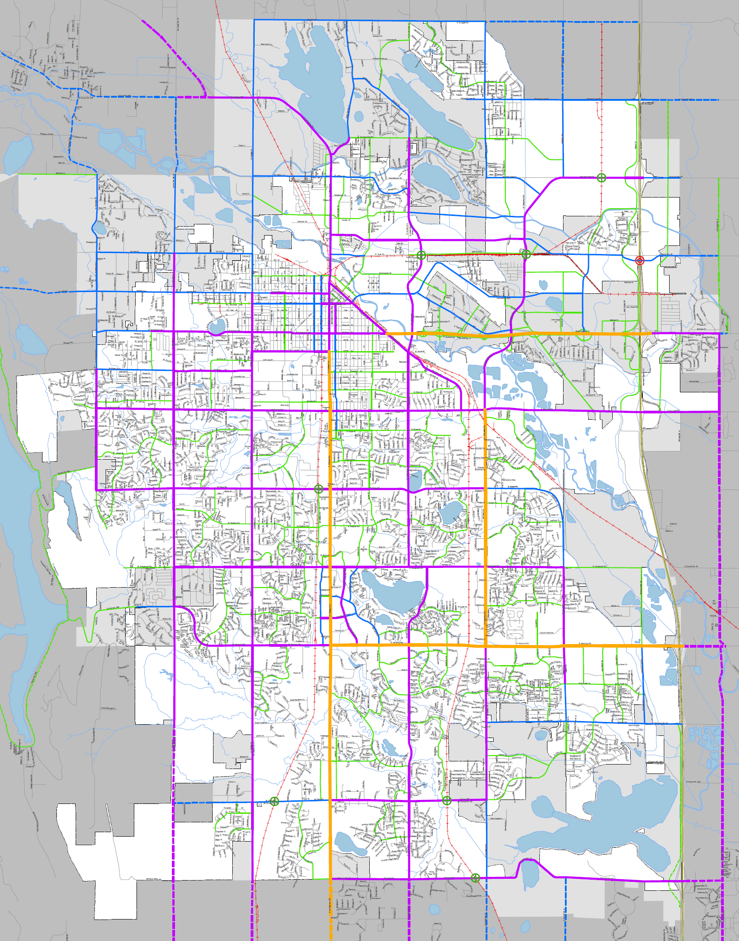
CSU
CSU
CSU
CSU

Slide 7
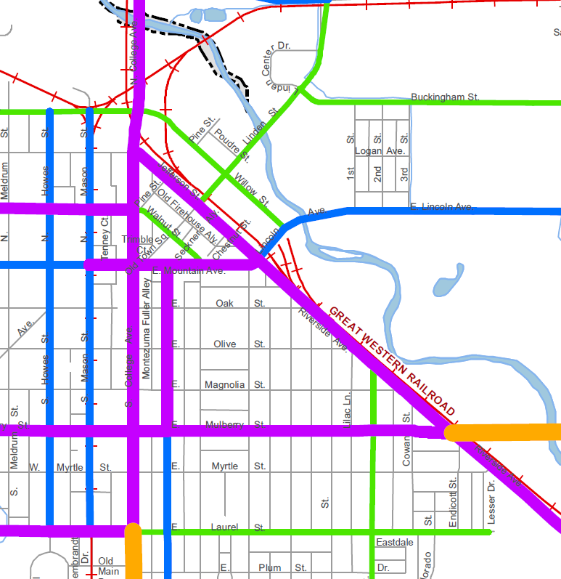

Slide 8
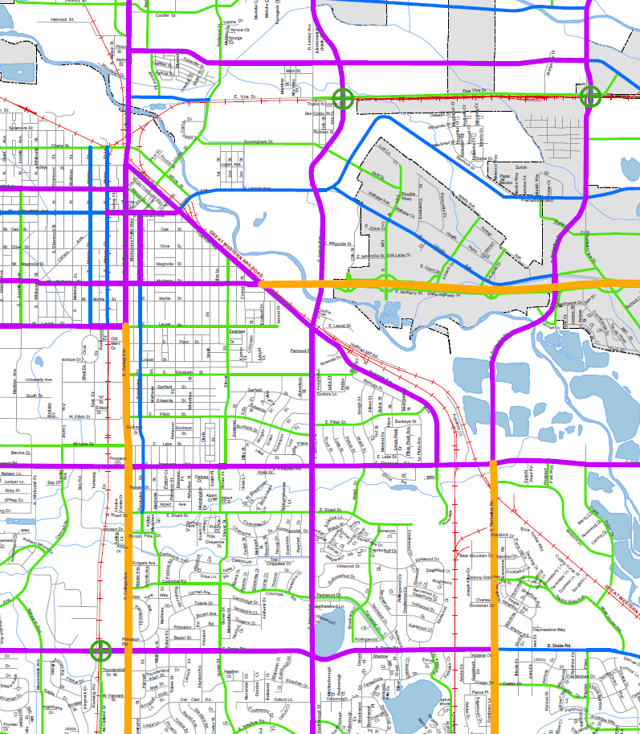




Slide 9
20’s-50’s
80’s
60’s
70’s
80’s
90’s
2000’s

Slide 10
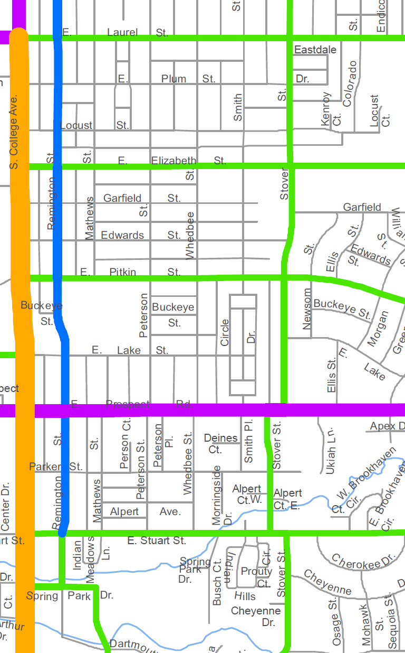

Slide 12
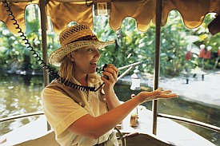
MODULE: Buyer Tour
The more you know about the cities you serve – the more comfortable your clients will feel with you.

Slide 13


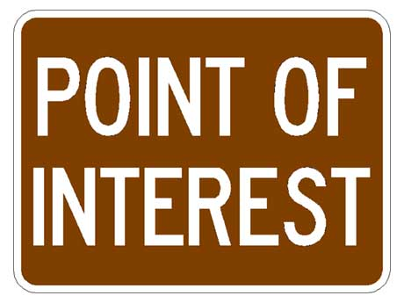
MODULE: Buyer Tour
Notes:
Develop a Buyer Tour with your Buddy this week – Go to Linda’s presentation at Rookie Club then build your own driving tour or walking tour of different areas.

